Slide 1


Capture The Flag
NAME: Reece Zunino
Team Name: Hash it out!
Notes:
My name is Reece Zunino and I will be covering one of the Capture the Flag challenges for our team Hash It Out!

Slide 2
Introduction
The CTF Problem
Steps to Solve
The Solution
Workplace Relevance
Notes:
In Section 1, provide some background of the category of your CTF challenge.
The category of this CTF challenge is Log Analysis. It’s essential for ethical hackers to be able to search though a log file and to find key words or hash lines that can be used to find out more on the system you are trying to get into. Sometimes this information can be hidden in plain sight.
Introduce the audience to the problem and tell us how you plan to approach it and get the solution.
The type of file we have here is a log file from a software Microsoft Internet Information Services 7.0. In this problem we are trying to determine how many times system administrator shows up within the log file.
In Section 2, cover the steps you used to solve the problem.
In Section 3, talk about how you found the solution and discuss the pitfalls and recommendations when facing these types of problems.
In Section 4, talk about the relevance of Capture the Flag problems to the workplace and your job role.

Slide 3
CTF Category Description
The CTF Challenge category is log analysis.
The skills needed to find the flag in the log file is the ability to use Notepad ++ or any similar tool.
This CTF relates to Ethical Hacking in that it shows an individual how to search though a log file for specific criteria when looking for passwords or users within the file to find data that can be exploited
The lab that is close to covering log analysis would be module 6. This lab has you use notepad++ in analyzing a log file
Notes:
Describe the category of question that you attempted.
The category of this challenge is Log Analysis in which I needed to identify how many times Administrator appears in the log file. Log analysis can tell you information about the system you are trying to penetrate. The information will vary based on the type of log you are analyzing.
What is the important background knowledge needed?
Ethical hackers need to know how to analyze log files because the information you are looking for can be hidden in plain sight. That information can be used both in offense and defense of systems. Logs can show you if someone has gotten into the system if they didn’t cover their tracks or give you the information you need to gain access.
How does this relate to the Ethical Hacking course?
This relates to Ethical Hacking course due to the necessity of both looking through a log file to find information and how to cover your tracks by manipulating log files.
What lab in the course covered the topic from this CTF problem?
Chapter 7 and Module 7- Lab 4.

Slide 4
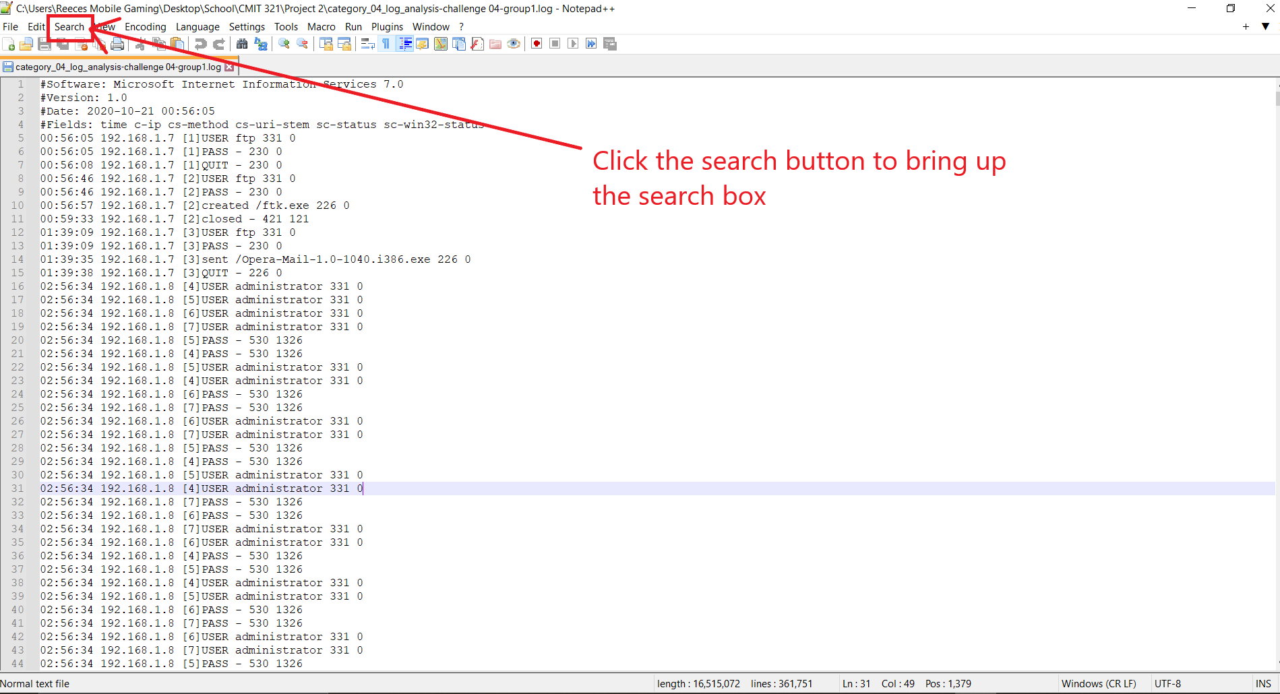
Introduction to the Problem
Notes:
Text for narration:
Open the file using Notepad++ or any other type of text file application viewer. Notepad++ is prefeed for me due to my familiarity with it and the built-in search function that has a word count option.

Slide 5
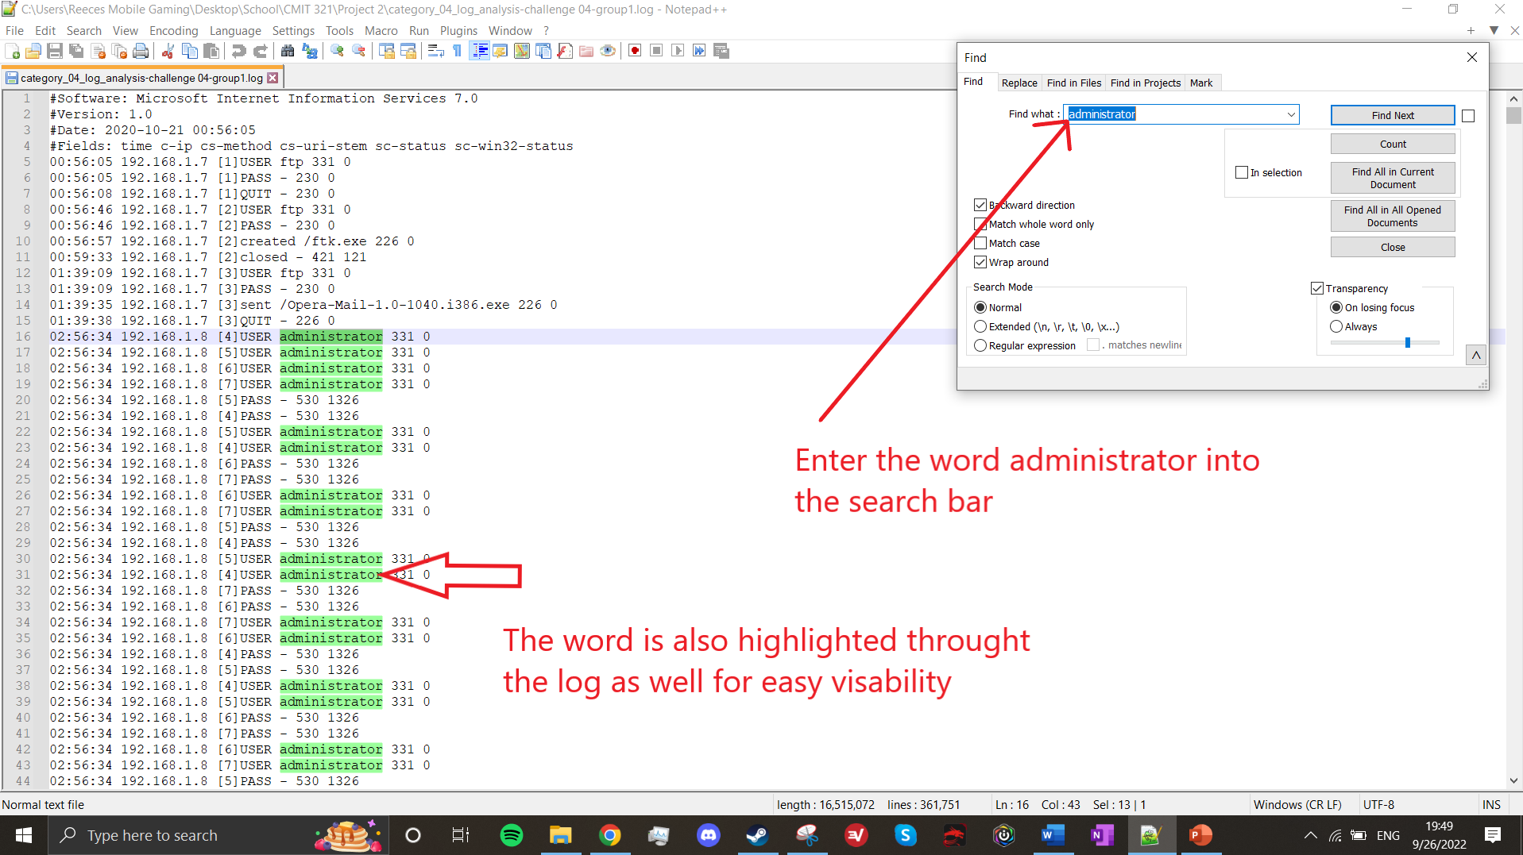
Working Toward a Solution
Notes:
Text for narration:
When the search box opens click on the Find what search box. Then type in Administrator into the search box.
Once you click the find button all the words that say Administrator will be highlighted in color thought the entire Log file.

Slide 6
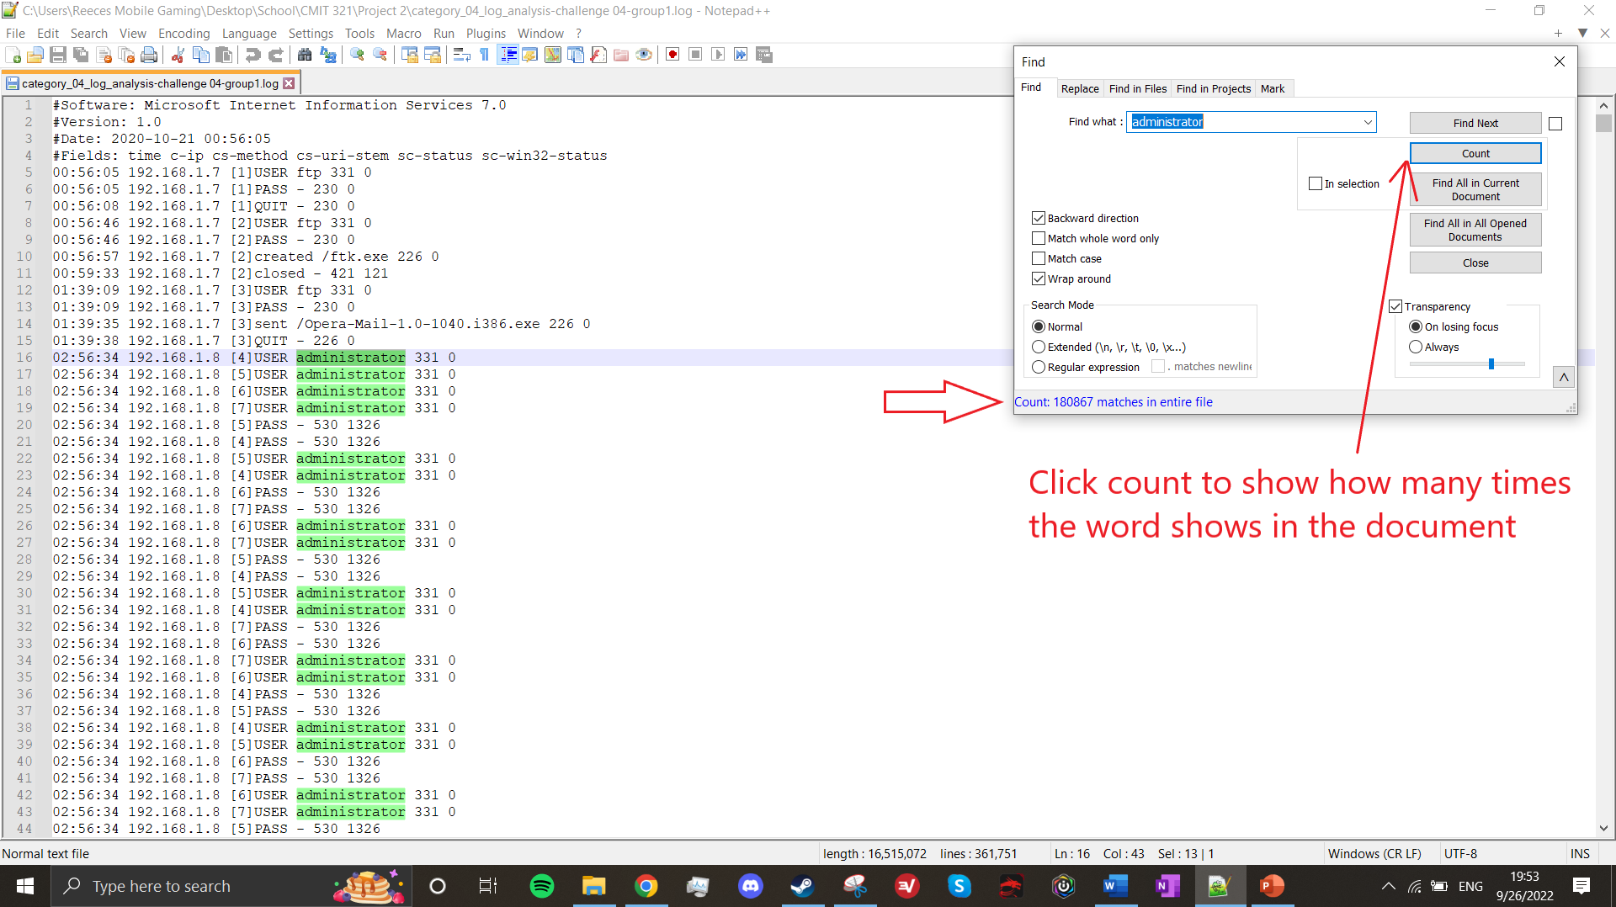
Arriving at the Solution
In the search box click on the count button. The amount of times the word is found in the document will show in blue on the bottom left corner of the search box.
This provided me with the flag and allowed me to solve the log analysis capture problem for Team #1 aka Hash It Out!. The CTF answer is 180867.
The screenshot below includes the date/time from the host system.
Notes:
Text for narration:
In the search box click on the count button. The amount of times the word is found in the document will show in blue on the bottom left corner of the search box.
This provided me with the flag and allowed me to solve the log analysis capture problem for Team #1 aka Hash It Out!. The CTF answer is 180867.

Slide 7


Strategies, Pitfalls, Lessons Learned
Us the right tool for the job.
Not all notepad tools are created equal
Word and notepad can also be used for this CTF
Using the wrong tool can lead to not solving the problem
Notes:
It is very important to use the right tool for the job. This will always be the best strategy when analyzing Log files. There are many different applications that can open a log file and the one you are more familiar with could be the best way for you.
Potential Pitfalls:
Depending on the type of log you are analyzing will determine the information you are trying to gather. This can be anything from hash lines to try and find user or admin passwords or even how many attempts there have been to try and access a system or application. Ensuring you take your time and analyze the information you need can get you to your task at hand. However, it can also lead you in the wrong direction if you don’t know what information you're looking for.
Lessons Learned:
Always stay familiar with notepad tools. They are a key function when analyzing log files.

Slide 8
The Relationship to the Workplace
Builds team cohesion and moral
Challenges members within the workplace in a fun and educational environment
Allows employees to have lessons learned when solving CTFs that maybe they are not very experienced in
CTFs are valuable for sharpening the skills of technical operators. Just like athletes who constantly train to stay in top shape, cybersecurity experts need to keep on top of their game (Clarke, 2021).
Notes:
Capture The Flag challenges can benefit a workplace environment in different ways. It can help build team cohesion and even boost moral. It can also lead to workers being competitive and engaging. It can also foster a fun learning environment based off the challenges. CTFs are a valuable tool for honing your skills as an ethical hacker in all team aspects in both offense and defense.

Slide 9
Summary
Try out different tools and applications to see what is more comfortable for you to use
Ensure you use the correct tool or application to find the answers you're looking for in the CTF
Hone your skills doing CTFs on your own using websites like HacktheBox and TryHackMe
CTF challenges in the workplace can be fun educational and a boost to moral amongst all employees involved
Notes:
In summary we used Notepad++ to find the answer to our CTF challenge. There are different types of text applications that can view a log file, even Word can open a logfile but that doesn’t mean it will help you find the answers you're looking for. So, ensure you use one that benefits your needs and become familiar with that application.
You can always hone your skills in other ways as well by using sites like HacktheBox and TryHackMe. These sites are one on one training tools to help you find different flags in a fun and engaging environment. Also remember that CTF challenges can be fun, educational and even competitive in a workplace environment.
This concludes my presentation.

Slide 10
References
Clarke, J. (2021, February 2). Capture the flag competitions can help close the security skills gap. Security Intelligence. https://securityintelligence.com/capture-the-flag-competitions-can-help-close-the-security-skills-gap/
Estrera, M. (2022, August 4). A guide to Notepad++: Top use cases and pro tips. Career Karma. https://careerkarma.com/blog/how-to-use-notepad-plus-plus/
HO, D. (2008, November 3). Notepad++ User Manual. Notepad++ User Manual. https://npp-user-manual.org/docs/searching/

